Slide 1
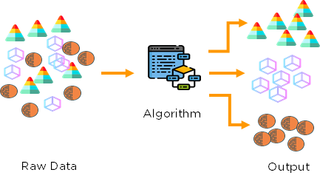
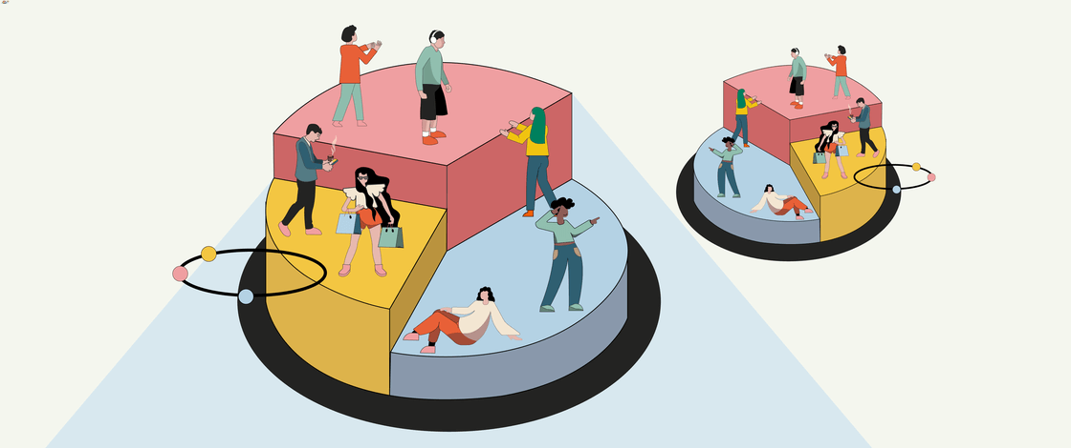
STAT 430 : Customer Segmentation Analysis for Marketing Campaign
Prepared and Presented by
Debapratim Ghosh (dg19@illinois.edu)
Mayank Agarwal (mayanka5@illinois.edu)
Notes:
Cover Slide Option 1

Slide 2
Agenda
Introduction
Data Understanding and Research
Explanatory Data Analysis
Data Exploration
Analysis Objective
Algorithm Selection
K-means Results
Hierarchical Agglomerative Clustering Results
Gaussian Mixture models Results
Algorithm Comparison and Results
Post Analysis Questions
Analysis and Conclusion

Slide 3
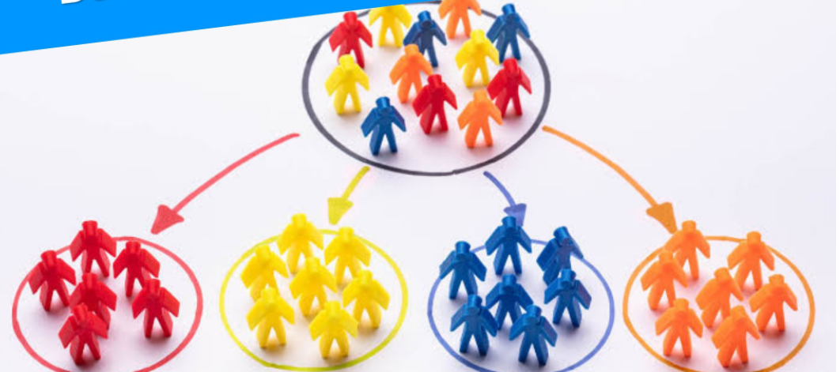
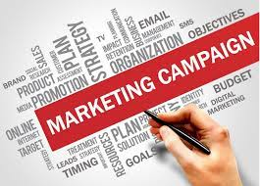
Introduction
We explore a dataset of customers for a retail firm to understand customer purchase behavior to increase effectiveness of a marketing campaign.
Customers can be segmented to :
Find High value customers
Offer personalized products or campaigns
Improve customer engagement and Brand Loyalty
Enhance channel of distribution
Existing customer database can be leveraged to maximize profits and minimize customer acquisition costs.
Main Research goals in our analysis :
Identify segments of customers.
Find major channels of purchase for each cluster
Unique group of customers and what makes them unique.
Customer characteristics for each cluster and sub cluster.

Slide 4

Data Understanding and Research
Dataset contains information of each customer :
Personal Information
Spend Behavior
Response to Deals and Promotions
Channel of Purchase
Creating a successful marketing campaign can be built on information such as :
Shopping Behavior
Stage of Life
Customer Mindset
Need for building marketing campaign based on Customer Segmentation :
Harvard Business study found that 85% of 30000 new consumer products launched in a year failed to meet target revenue due to poor market segmentation.
Failure for new products launched in grocery sector is 70 – 80%
Marketers have seen 760% increase in email revenue by segmenting campaigns.

Slide 5
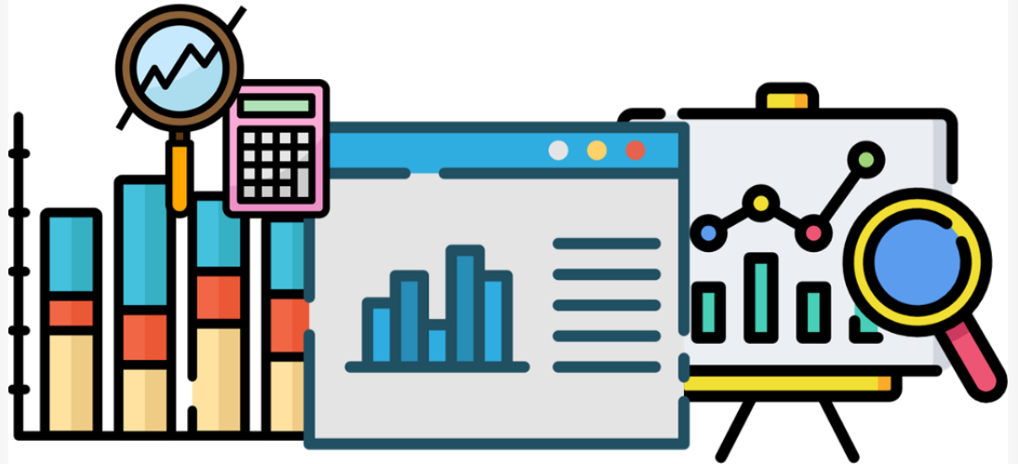
Exploratory Data Analysis – EDA
Check for missing values :
Used KNN imputer for variable having 1% or more missing values (Income) .
Feature Engineering :
Customer_For (days) from the enrollment date of customer.
Living_with – customer with partner or alone
Is_parent - using number of children
Spend – adding the amount on different grocery items.
Family Size – getting values from Living_with , and children
Drop redundant features like Id, DtCustomer
Numerical Summary :
Average annual income of a customer is 51687$ (USD) and average age is 52
The highest average amount is spent on wines – 303$
The next highest amount is spent on Meat, 166.9$ (avg)
Customers spend 44$ buying Gold products.
Scaling Decisions :
Some variable like Income have much higher standard deviation than other and might influence our results.
Hence we scale the numerical variables.

Slide 6
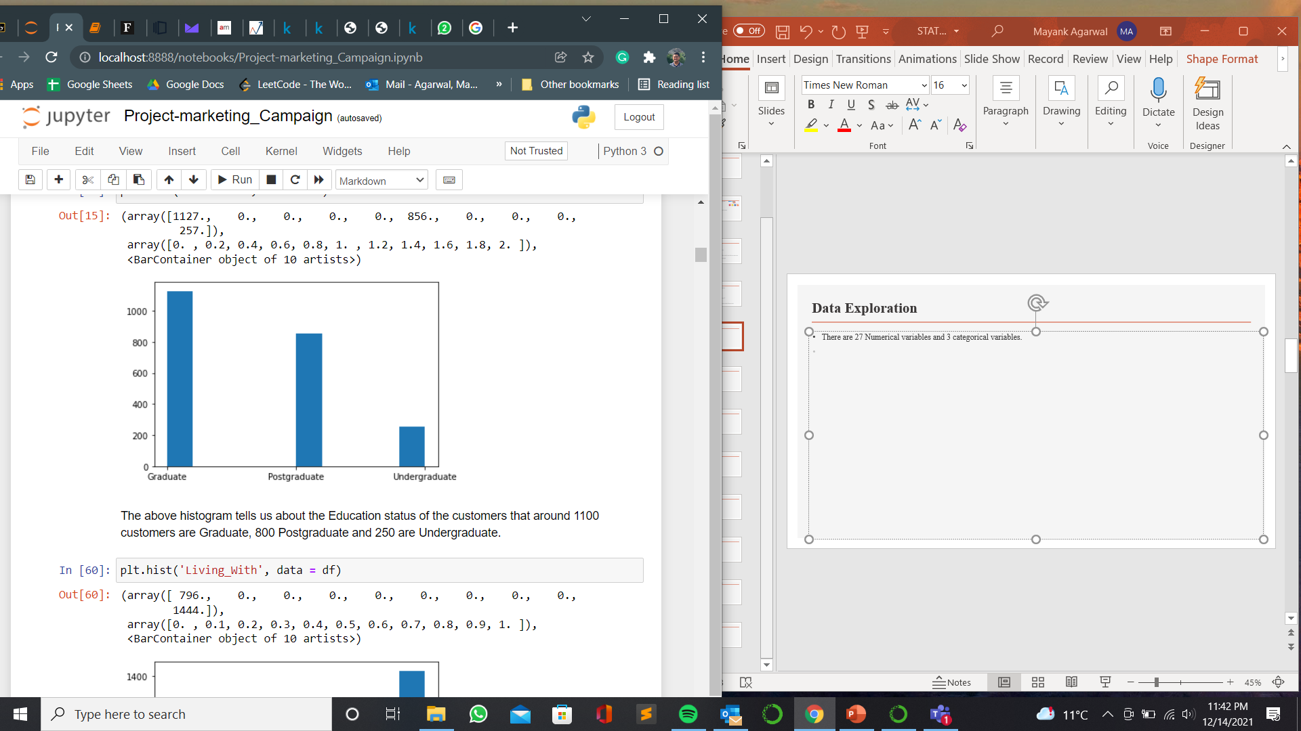
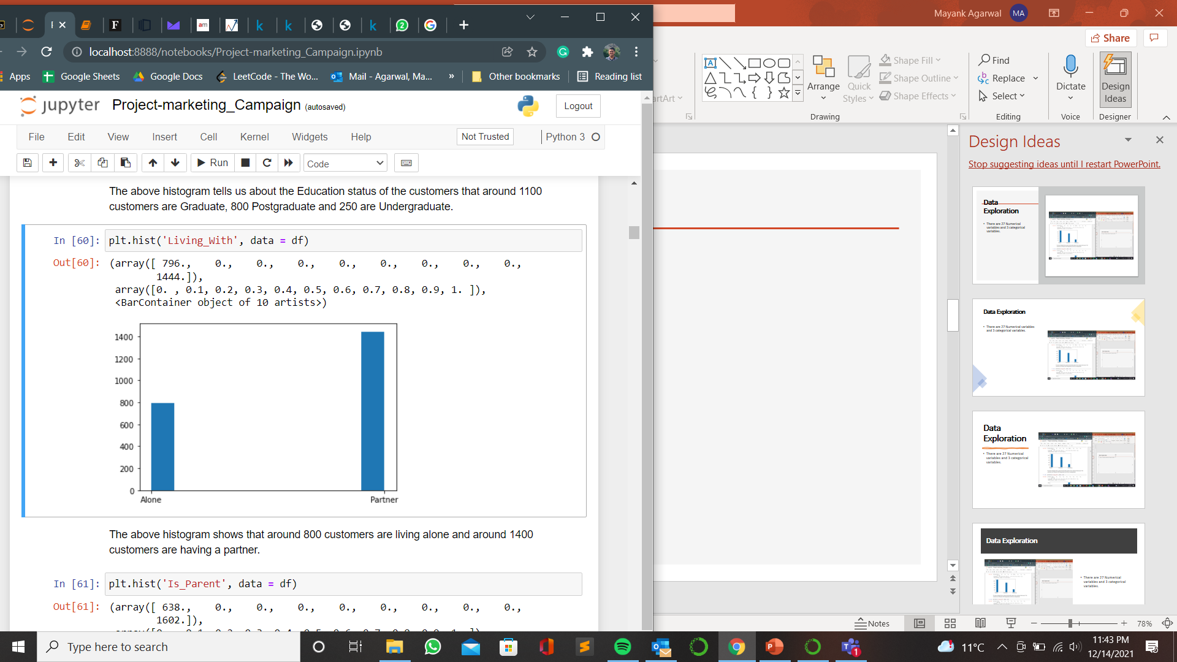
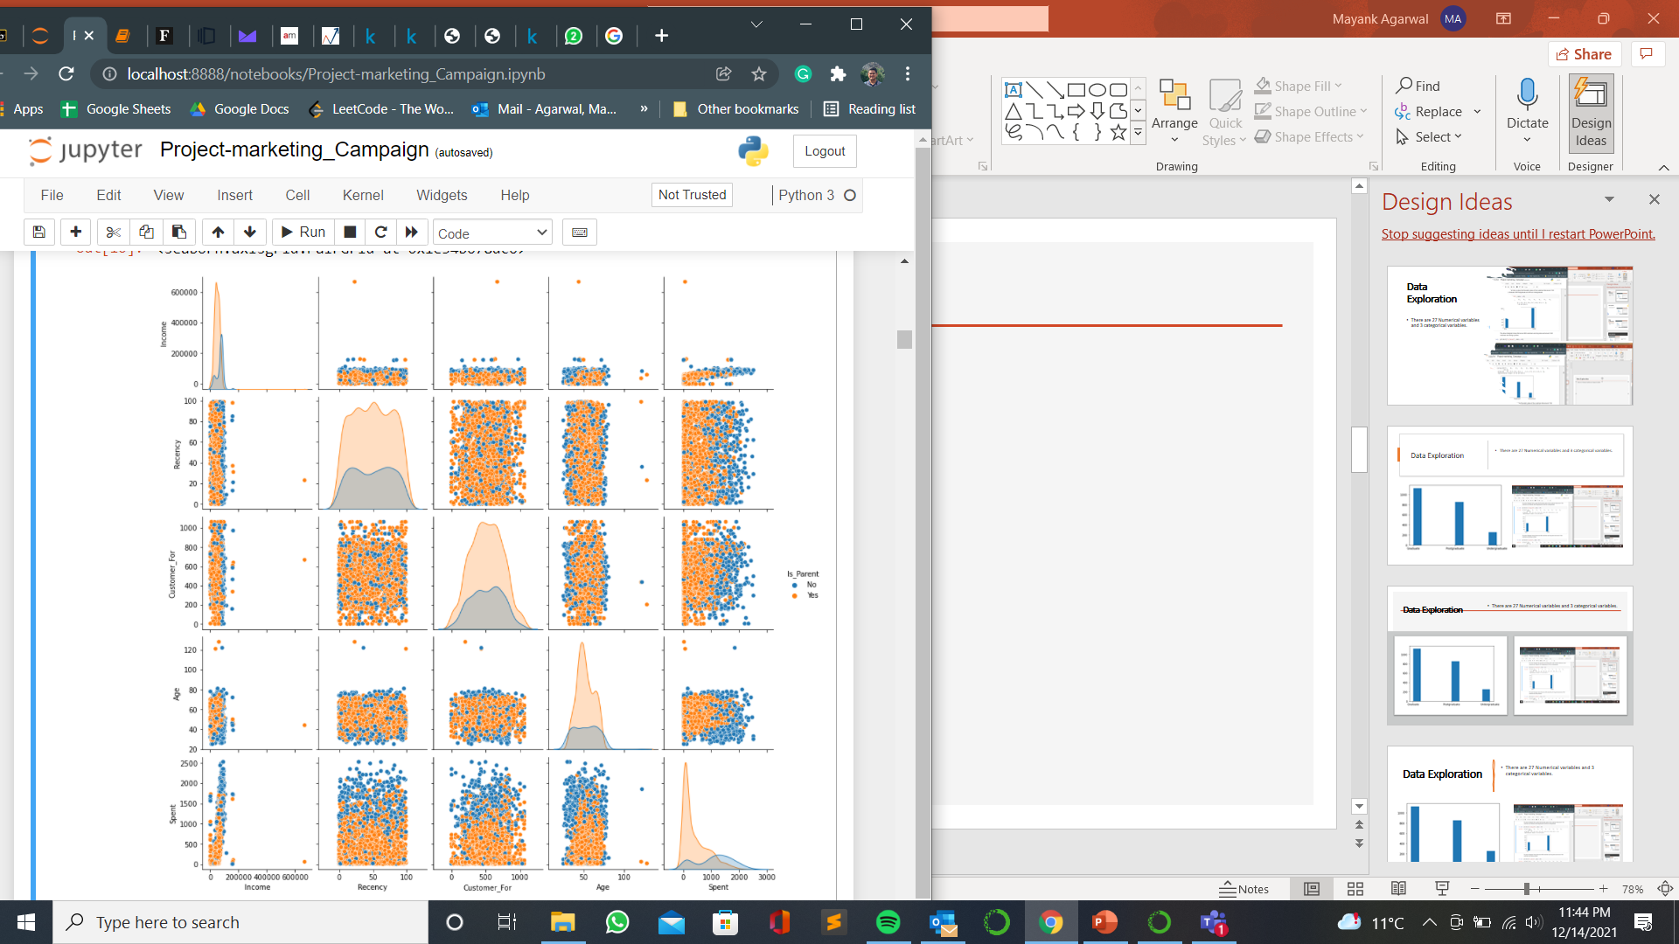
Data Exploration
There are 27 Numerical variables and 3 categorical variables.
Around 1900 customers have pursued higher education while 250 are only undergraduate.
800 customers are living alone and 1400 are living with a partner.
From the pairwise plots :
Some outliers in our dataset.
Customer who are parents have higher income and spend more. They have been customer for longer period of time.

Slide 7
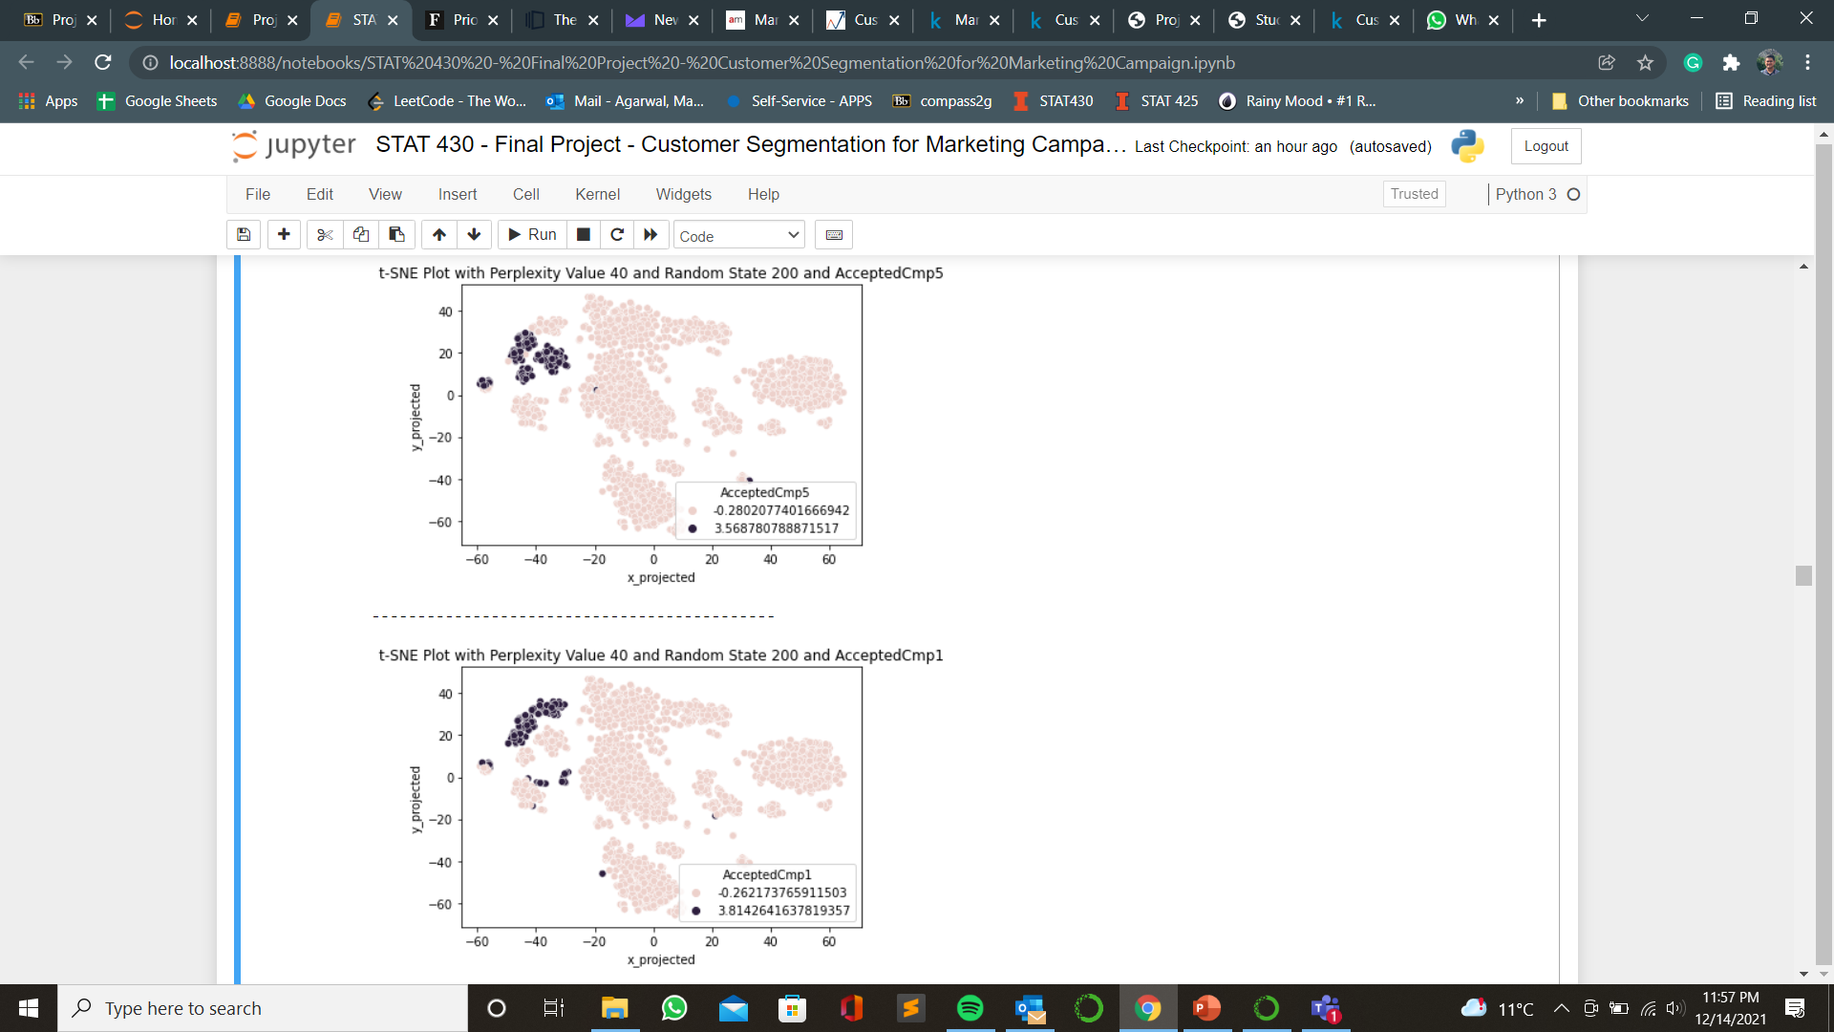
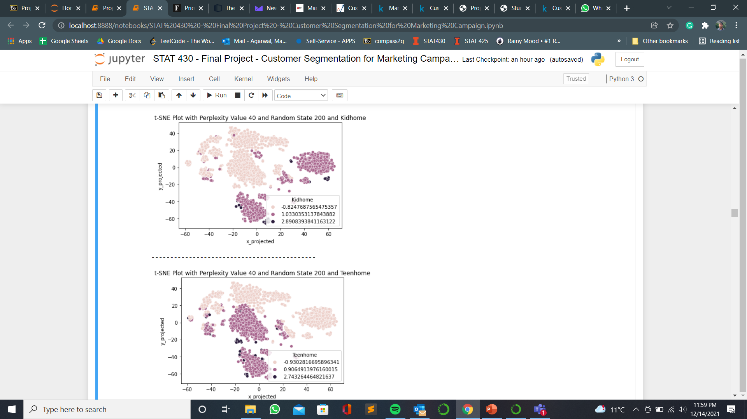
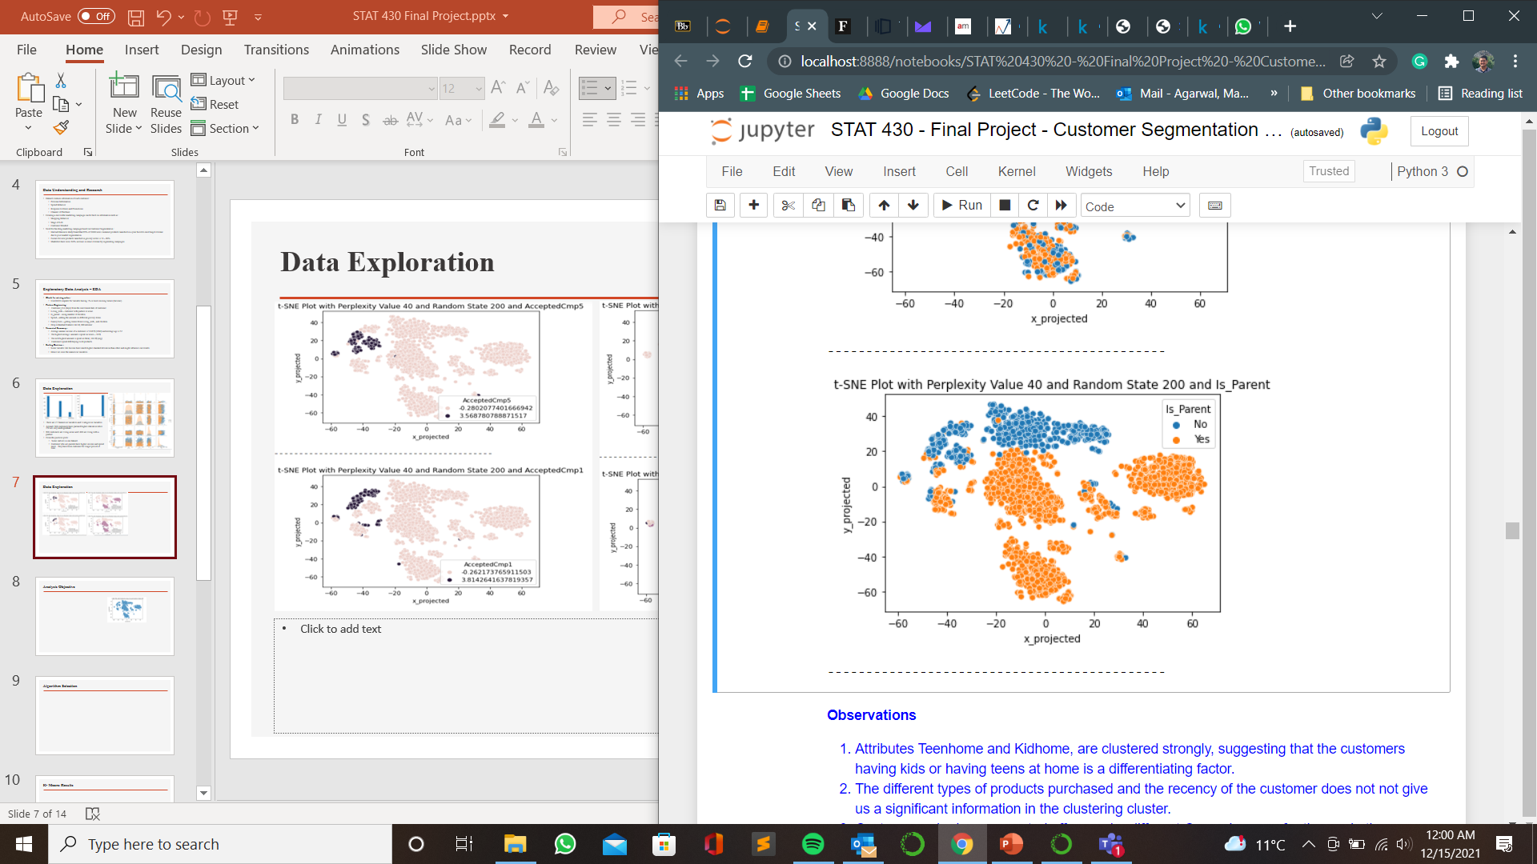
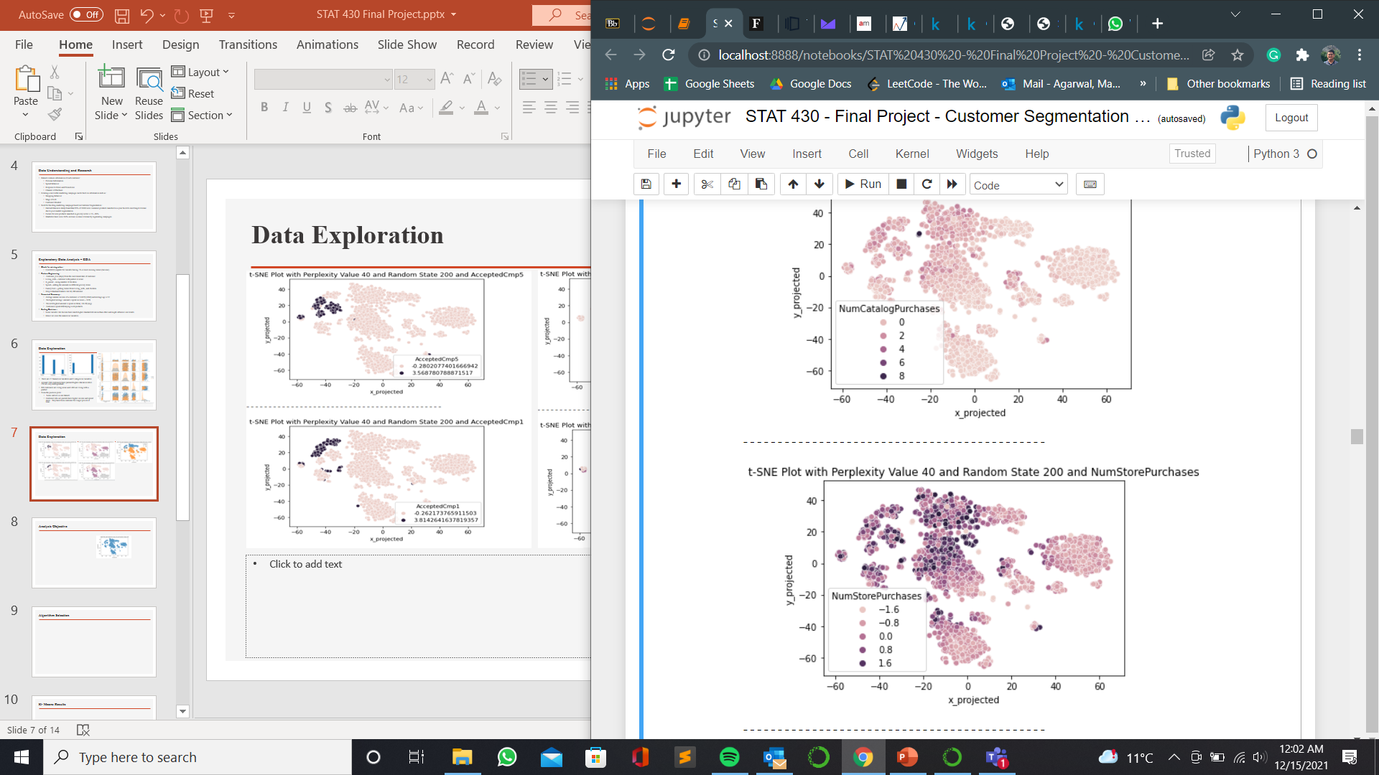
Data Exploration
Customers accepting marketing campaign offers are clustered together.
Attributes Teenhome and Kidhome are clustered strongly suggesting having children is a differentiating factor. Being a parent is also showing a clustering structure.
NumStorePurchases shows customers making store purchases have some clustering trend.

Slide 8
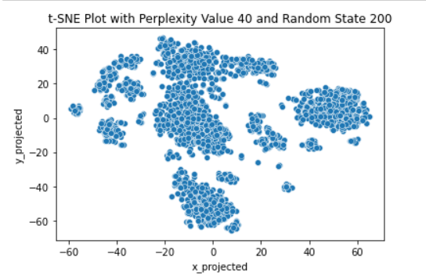
Analysis Objective
After standardizing we check for clusterability using :
Hopkins Statistic: The values are closer to 0 than 0.5, suggesting underlying cluster.
t-SNE Plots: perplexity values 0f 30,40,50 show there are 4 distinct clusters with some sub clusters.
One cluster is spherical in nature while other three are ellipsoidal.
We choose perplexity value as 40 and random state as 200, for our t-SNE plots and can see the most distinct clusters
There is some sort of overlap amongst the clusters.
The clusters seem to have same number of objects.
We select Clustering Algorithms based on our observations and try to find some insights about each of cluster .
We assess cluster cohesion and separation using :
Silhouette Score
Correlation between ideal sorted pairwise distance and actual matrix
Calinski and Harabasz score
We describe each of the clusters using numerical and categorical features and find insights, to build a successful marketing campaign.

Slide 9
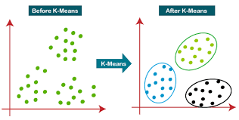
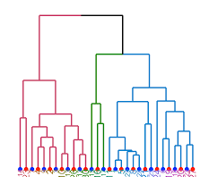
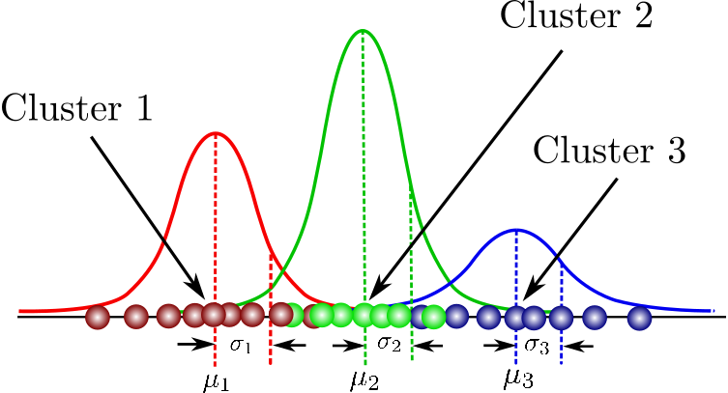
Algorithm Selection
K-Means :
The clusters are somewhat spherical, and do not have much noise.
By looking at t-SNE plots it seems that there are majorly 4 clusters.
The clusters have same sparsity.
It seems that each clusters have the same number of objects.
Hierarchical Agglomerative Clustering :
HAC tells us about the nested relationships, our t-SNE plots have some sub clusters.
There is some overlapping of clusters and single linkage does not work well.
Hence we explore the other linkages like complete, average and ward’s to find the clusters.
Gaussian Mixture Models :
It can detect cluster shapes present in our dataset (spherical and ellipsoidal).
We might be able to detect the random process of our dataset.
Since our dataset doesn’t have much outliers or noise, GMM might work well with our dataset.

Slide 10
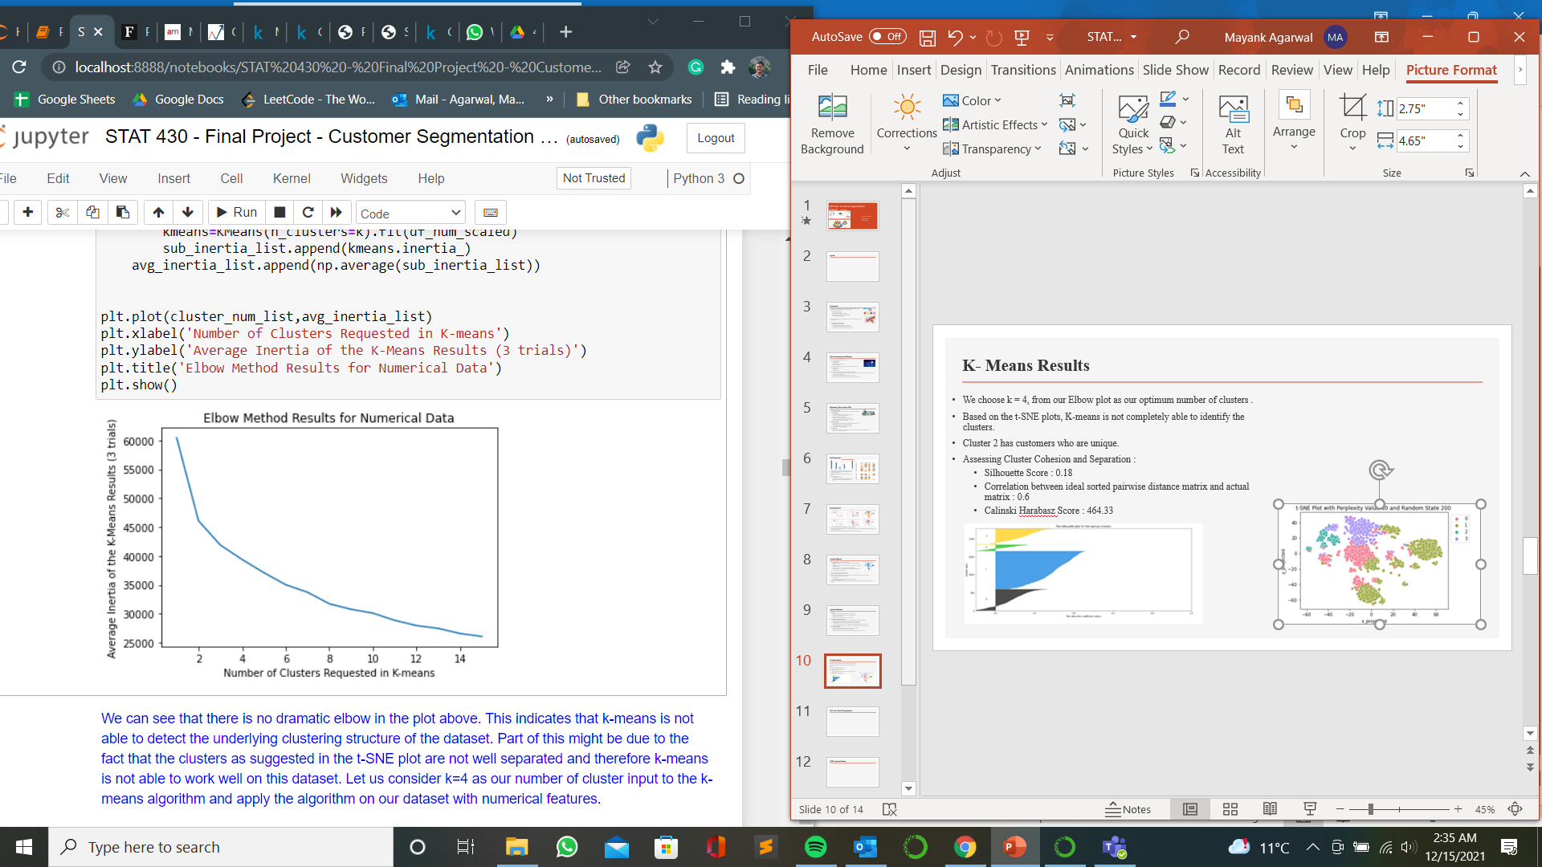
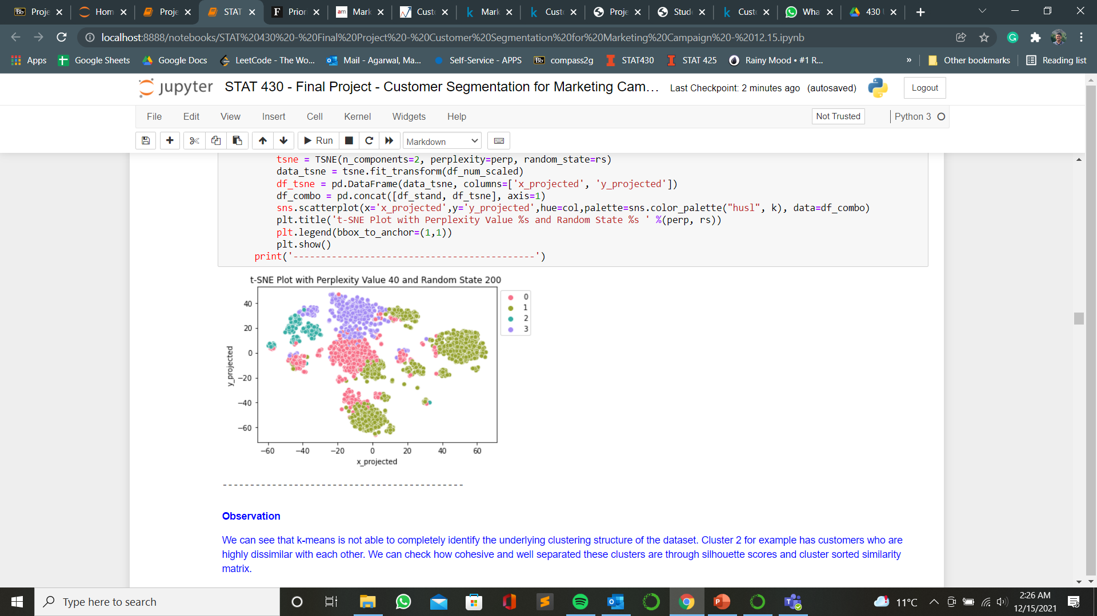
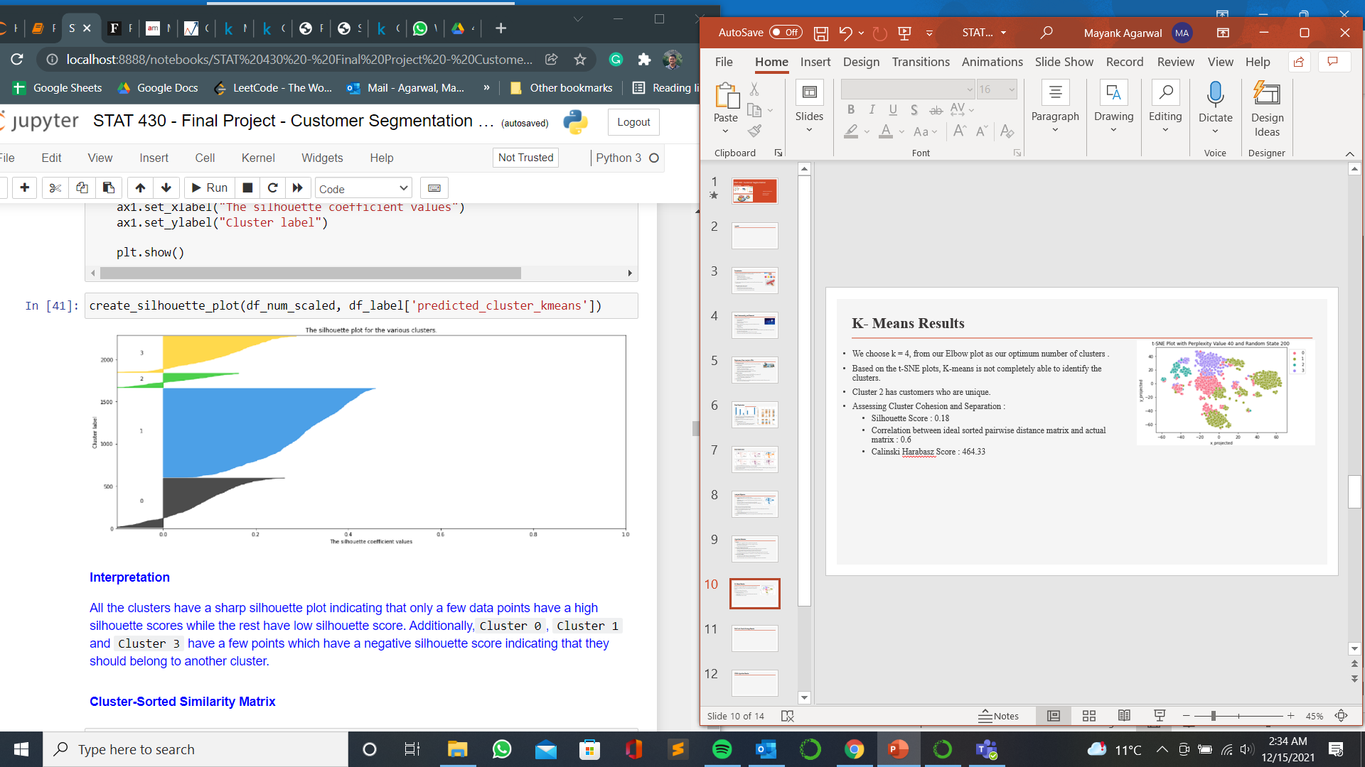
K- Means Results
We choose k = 4, from our Elbow plot as our optimum number of clusters .
Based on the t-SNE plots, K-means is not completely able to identify the clusters.
Cluster 2 has customers who are unique.
Assessing Cluster Cohesion and Separation :
Silhouette Score : 0.18
Correlation between ideal sorted pairwise distance matrix and actual matrix : 0.6
Calinski Harabasz Score : 464.33

Slide 11
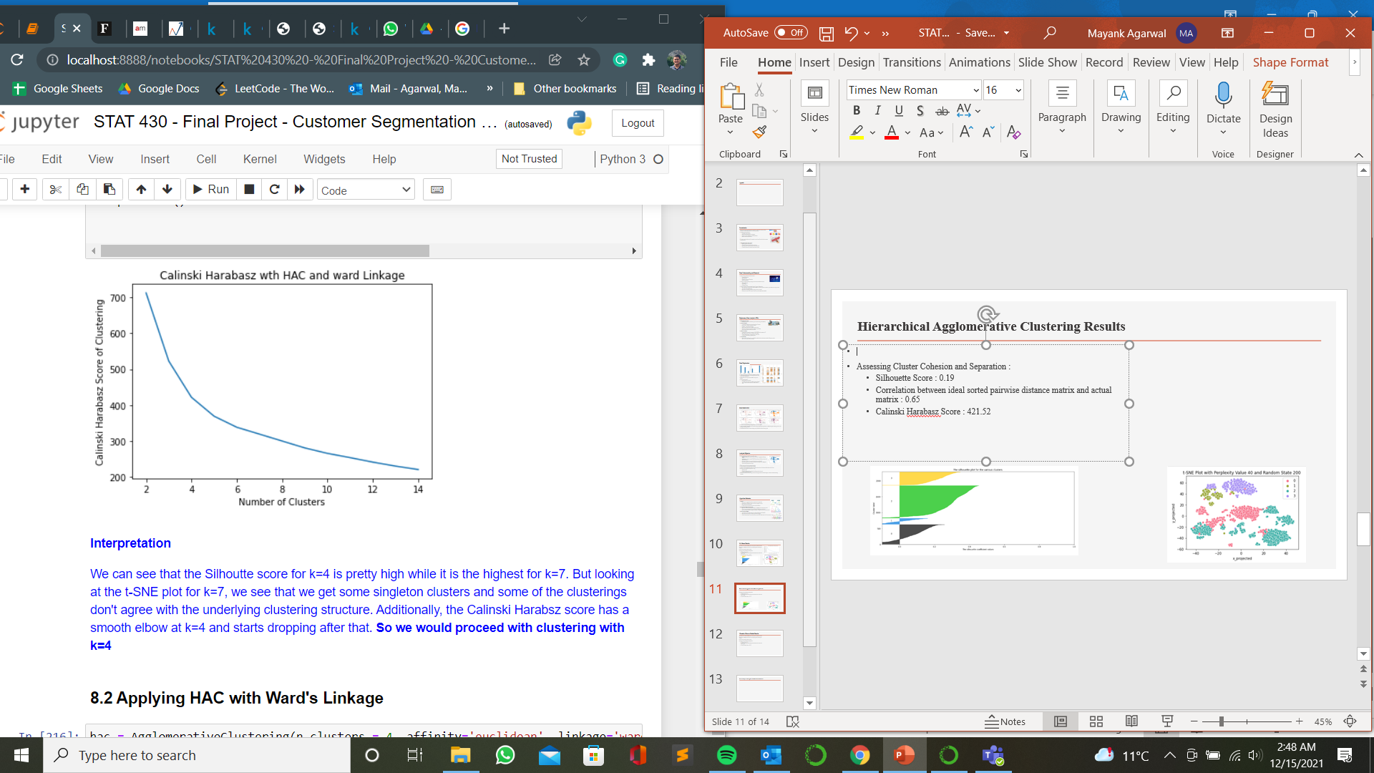
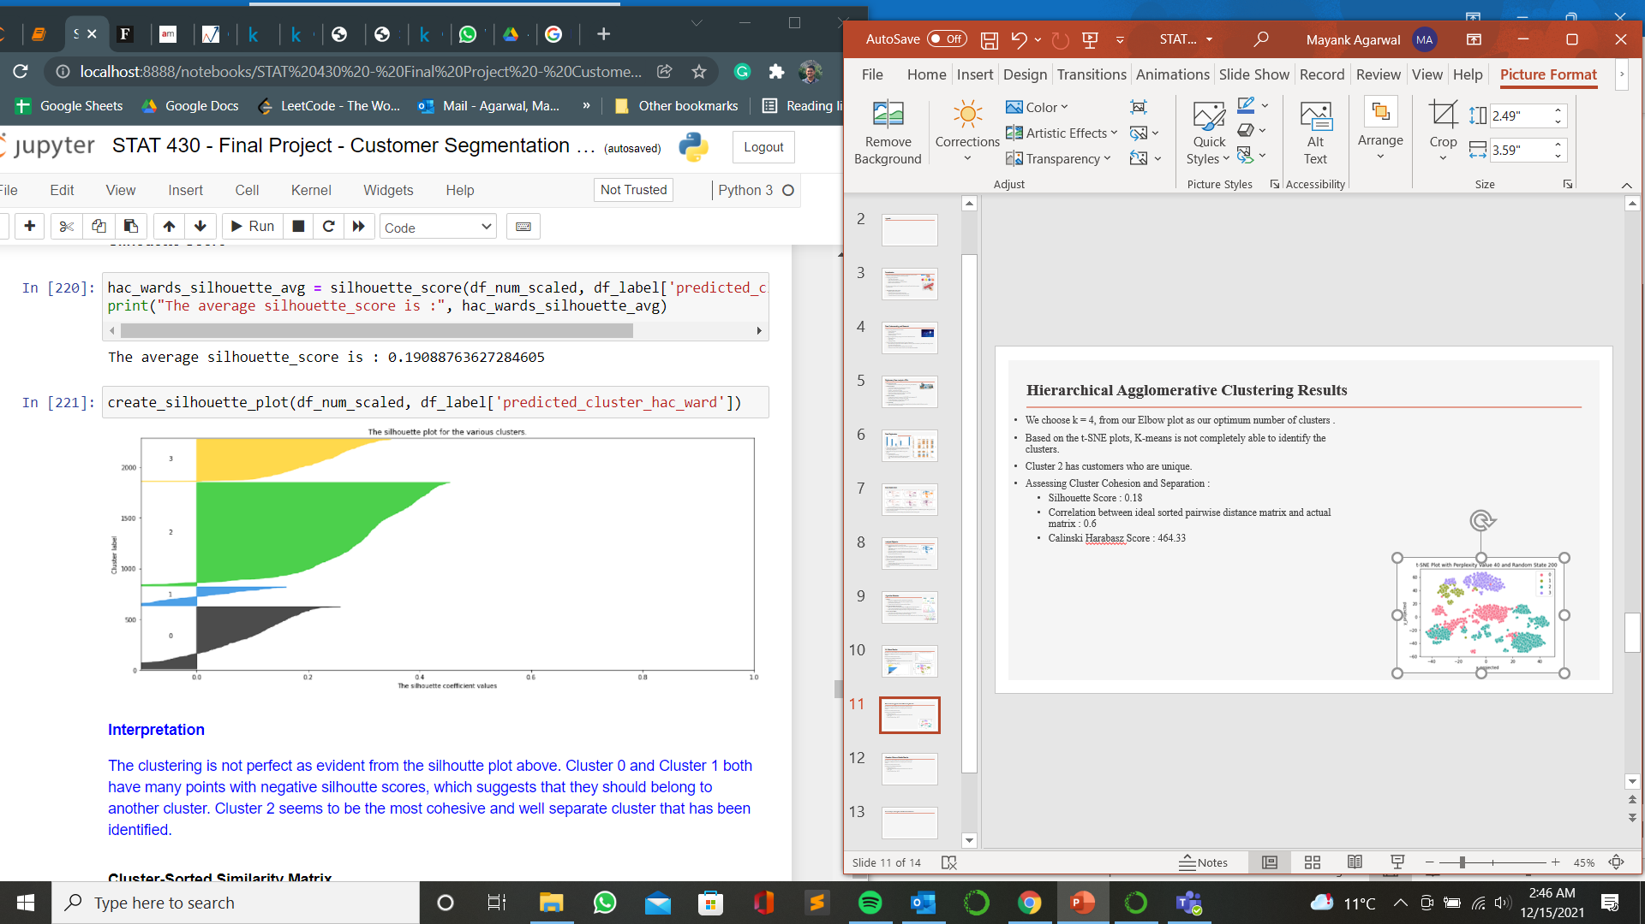
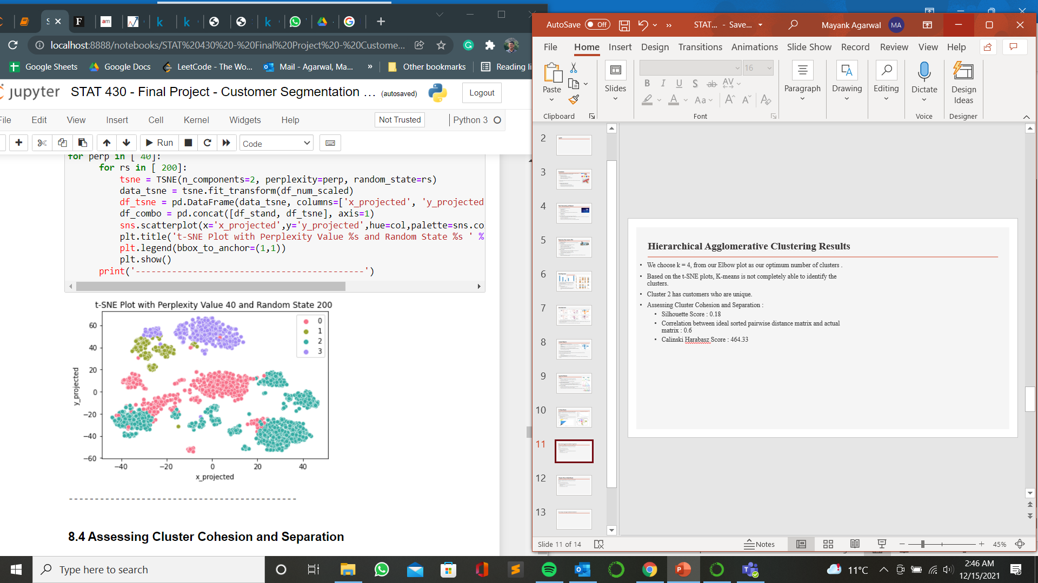
Hierarchical Agglomerative Clustering Results
Amongst the different linkages we find that HAC with ward’s linkage is the best to detect the clustering structure.
We find the number of clusters with highest Calinski Harabasz score.
Assessing Cluster Cohesion and Separation :
Silhouette Score : 0.19
Correlation between ideal sorted pairwise distance matrix and actual matrix : 0.65
Calinski Harabasz Score : 421.52

Slide 12
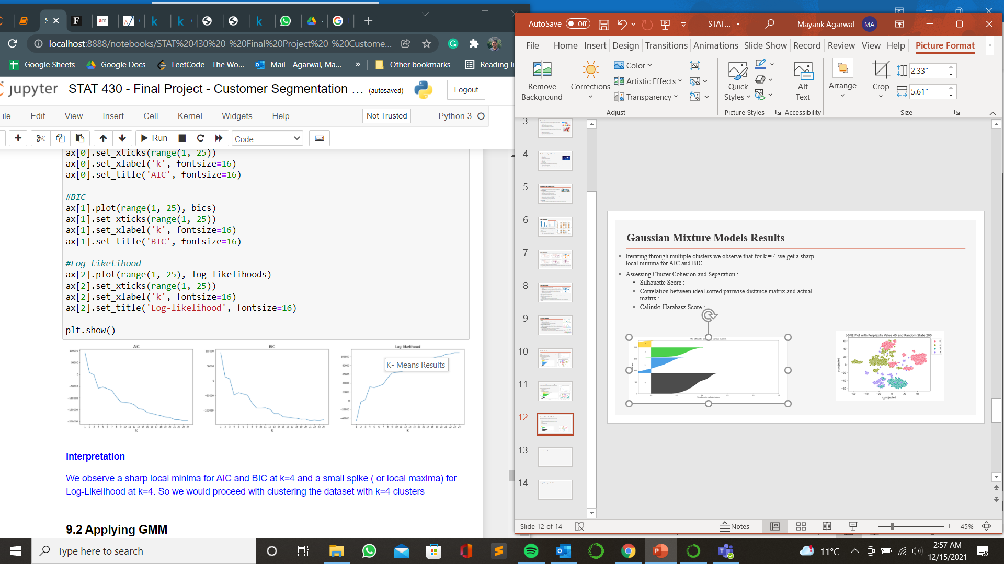
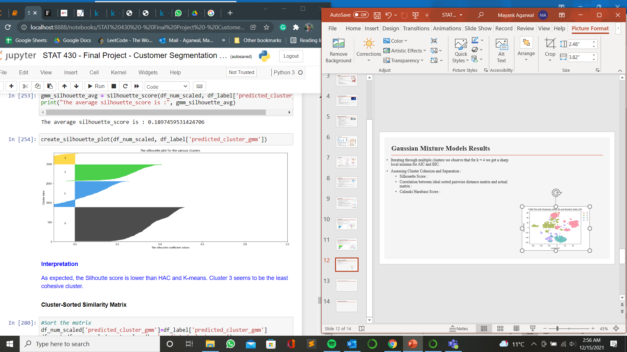
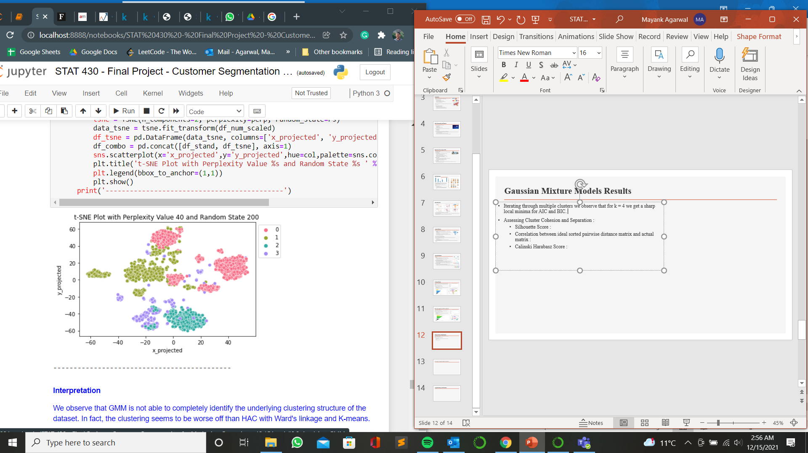
Gaussian Mixture Models Results
Iterating through multiple clusters we observe that for k = 4 we get a sharp local minima for AIC and BIC.
Assessing Cluster Cohesion and Separation :
Silhouette Score : 0.189
Correlation between ideal sorted pairwise distance matrix and actual matrix : 0.417
Calinski Harabasz Score : 379.17

Slide 13
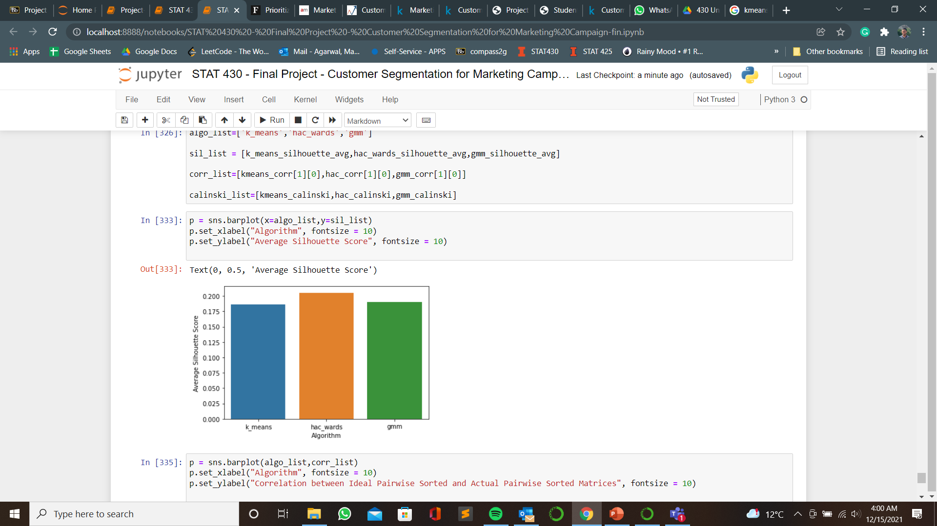
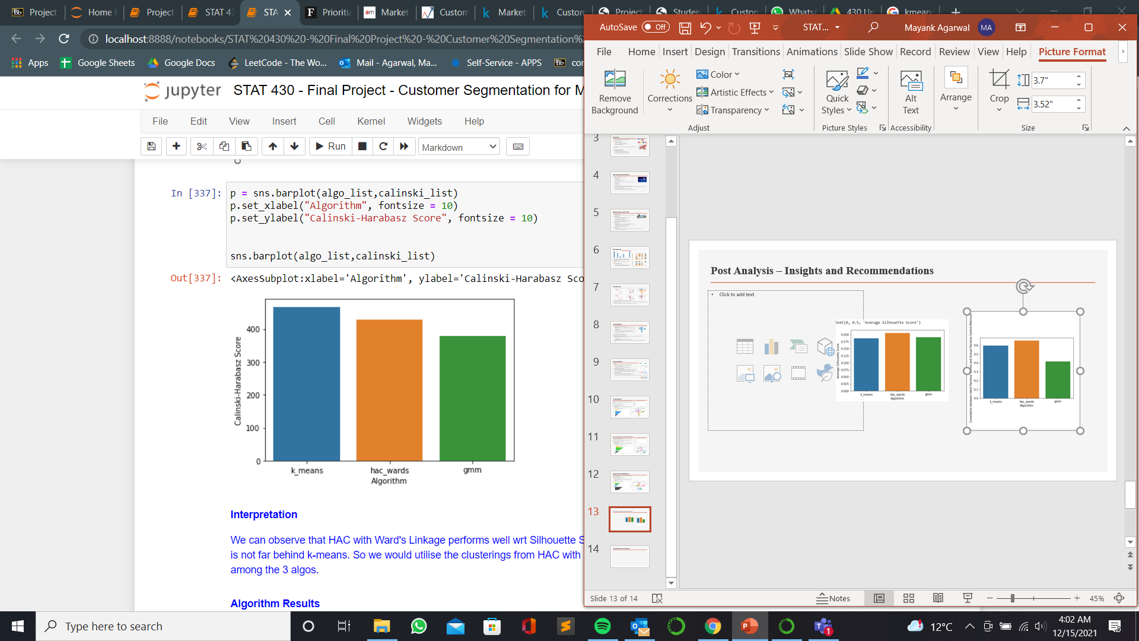
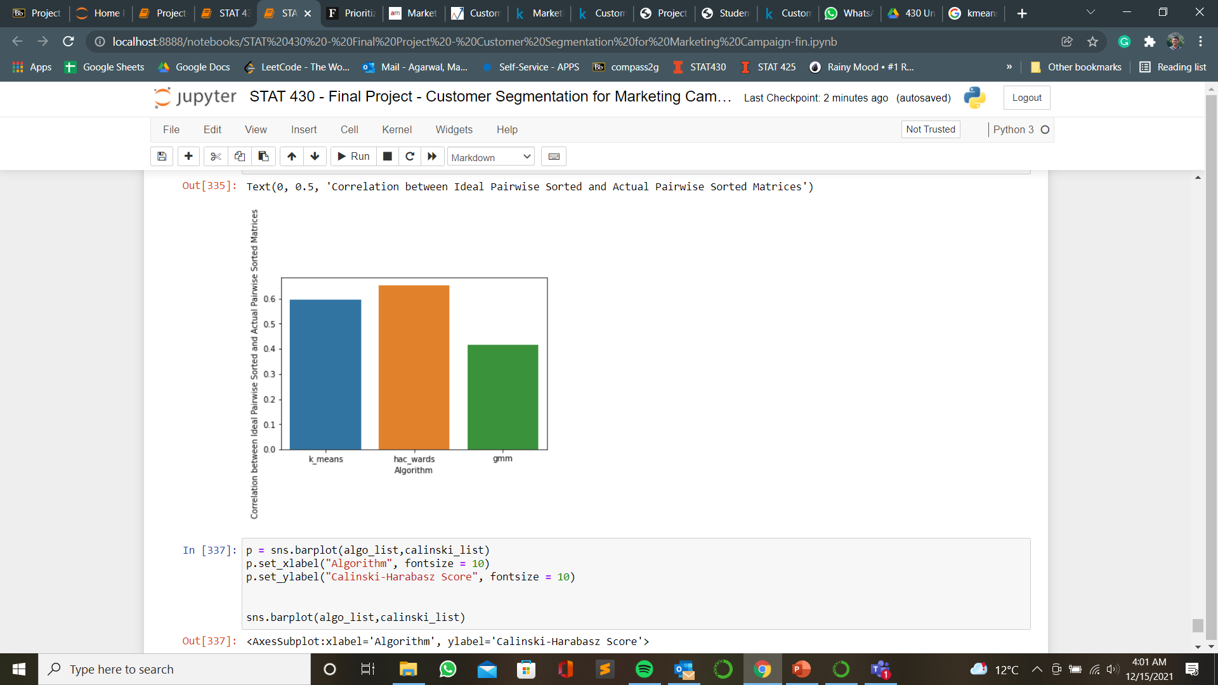
Algorithm Comparison and Results
Amongst the three algorithms we will use HAC with ward’s linkage as it performs best with silhouette score.
Adjusted rand Score:
Kmeans vs HAC ward’s: 0.82
HAC ward’s vs GMM: 0.656
Kmeans vs GMM: 0.698

Slide 14
Post Analysis Results
Customer Segments
Major Channels for Customer Segments
Cluster Defining Characteristics
The four broad categories recommended for customer segmentation :
Stars: High spending customers, often purchase high valued items like gold and wine.
High Potential: High spending habits with specific needs like groceries.
Need Attention: Moderately High Income, respond well to deals and promotions.
Low Value: Customers with lowest income, don’t respond to promotional campaigns.
Low Hanging Fruit : In-Store purchases bring in the highest revenue across all segment. Marketing campaigns could have special promotions in-store to further boost growth in sales as well as for new customer acquisition
Income
Spend Amount
Growth Area: Web and Ecommerce sales and purchases are one of the lowest among all the segments even though web visits across segments are relatively high. Web Sales can be boosted through SEO and special occasion discounts and subscriptions.
Family Size

Slide 15

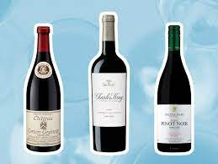
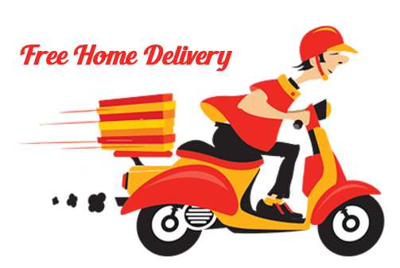
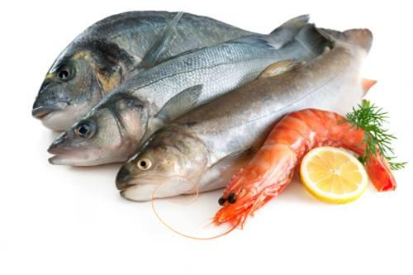
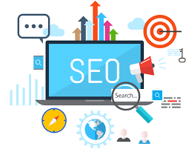

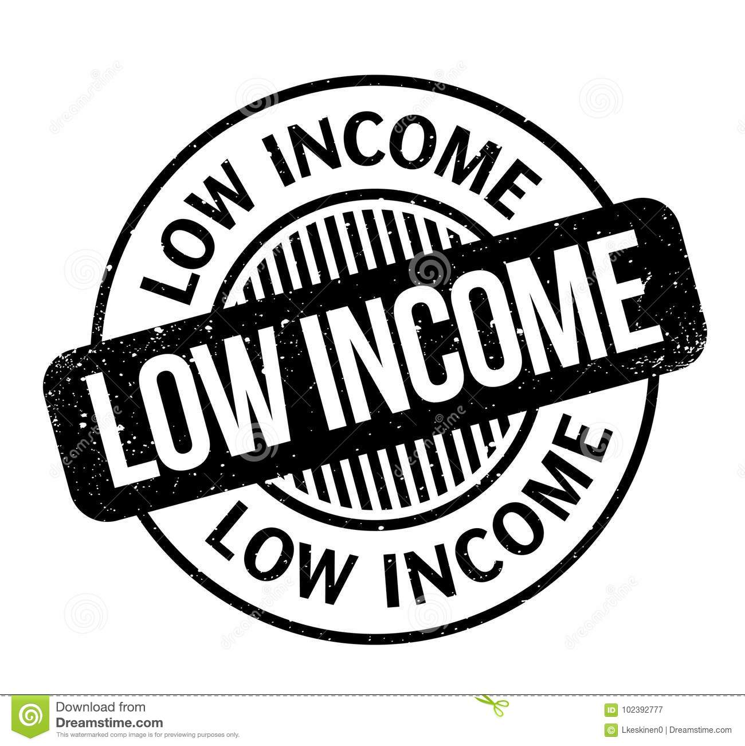
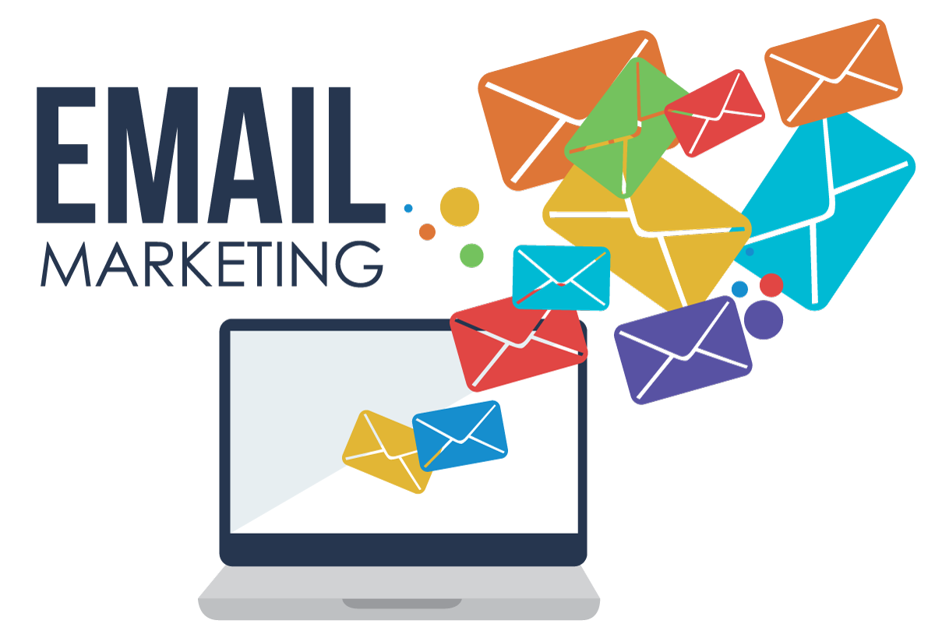
Analysis Summary and Conclusion
Star Customers: Spend on expensive items like gold and wine. Most live with partners and are without children. Mostly purchase in-store and have less web visits.
Recommendation: (Most valuable customer). Targeted digital ad placement redirecting to retail site. Loyalty discounts and gift to encourage retention.
High potential: Specific spending habits of daily needs like fish, meat, sweets. Customers are of higher age group and most purchase through catalog and ecommerce.
Recommendation: Campaign offering free home delivery (Senior citizens). Attractive subscription model can be introduced. Purchases made through all channels; incentives can be provided to grow a particular channel.
Need attention: Moderately high income, respond well to offers and campaigns. They have lower web visits and lower spend on groceries.
Recommendation: Free trial subscription of groceries to increase sales. Digital campaigns can be search engine optimized. More discounts to ensure higher purchases.
Low Value: Lowest income and lowest spending. They have high web visits, but most purchases are in store.
Recommendation: Marketing emails targeted during clearance sale weeks and seasonal ocassions. Marketing budget can be better utilized focusing on other segments of customers adding significant value.

Slide 16
Thank You !

